Slide 1
Software Life Cycle
Main issues:
Discussion of different life cycle models
Maintenance or evolution
©2008 John Wiley & Sons Ltd.
www.wileyeurope.com/college/van vliet
Notes:
© SE, Lifecycle, Hans van Vliet

Slide 2
Introduction
software development projects are large and complex
a phased approach to control it is necessary
traditional models are document-driven: there is a new pile of paper after each phase is completed
evolutionary models recognize that much of what is called maintenance is inevitable
latest fashion: agile methods, eXtreme Programming
life cycle models can be explicitly modeled, in a process modeling language
©2008 John Wiley & Sons Ltd.
www.wileyeurope.com/college/van vliet
Notes:
© SE, Lifecycle, Hans van Vliet

Slide 3
Simple life cycle model
problem
requirements engineering
reqs specification
design
design
implementation
system
testing
working system
maintenance
©2008 John Wiley & Sons Ltd.
www.wileyeurope.com/college/van vliet
Notes:
© SE, Lifecycle, Hans van Vliet

Slide 4
Point to ponder #1
Why does the model look like this?
Is this how we go about?
©2008 John Wiley & Sons Ltd.
www.wileyeurope.com/college/van vliet
Notes:
© SE, Lifecycle, Hans van Vliet

Slide 5
Simple Life Cycle Model
document driven, planning driven, heavyweight
milestones are reached if the appropriate documentation is delivered (e.g., requirements specification, design specification, program, test document)
much planning upfront, often heavy contracts are signed
problems
  feedback is not taken into account
  maintenance does not imply evolution
©2008 John Wiley & Sons Ltd.
www.wileyeurope.com/college/van vliet
Notes:
© SE, Lifecycle, Hans van Vliet
Important point to make: this is a management instrument, to control progress, rather than a development model

Slide 6
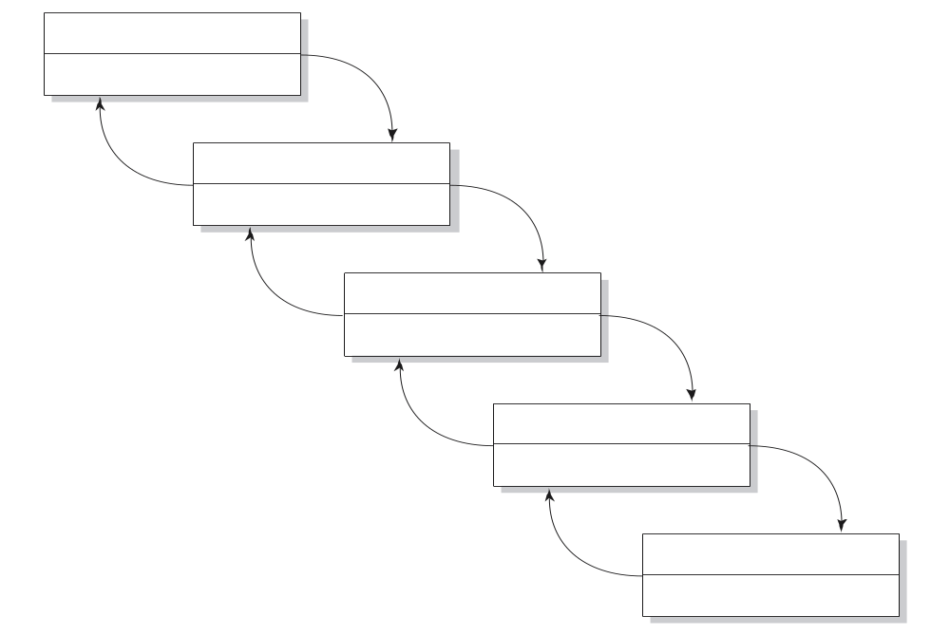
Waterfall Model
reqs engineering
V & V
design
V & V
implementation
V & V
testing
V & V
maintenance
V & V
©2008 John Wiley & Sons Ltd.
www.wileyeurope.com/college/van vliet
Notes:
© SE, Lifecycle, Hans van Vliet
The waterfall model emphasizes iteration, caused by verification and validation steps.
This model became widely known after Boehm’s 1976 article, but goes back to the sixties.
The model is meant for salmon, not for people

Slide 7
V-Model
reqs eng
acceptance
testing
global design
integration
testing
det. design
unit testing
coding
©2008 John Wiley & Sons Ltd.
www.wileyeurope.com/college/van vliet

Slide 8
Waterfall Model (cntd)
includes iteration and feedback
validation (are we building the right system?) and verification (are we building the system right?) after each step
user requirements are fixed as early as possible
problems
  too rigid
  developers cannot move between various abstraction levels
©2008 John Wiley & Sons Ltd.
www.wileyeurope.com/college/van vliet
Notes:
© SE, Lifecycle, Hans van Vliet

Slide 9

Lightweight (agile) approaches
prototyping
incremental development
RAD, DSDM
XP
©2008 John Wiley & Sons Ltd.
www.wileyeurope.com/college/van vliet
Notes:
© SE, Lifecycle, Hans van Vliet
XP = eXtreme Programming
DSDM = soort geformaliseerde RAD
RUP: zware methode iteratief
Open Source: beetje vreemde eend in de bijt, maar trekt veel aandacht bij de overheid

Slide 10
Agile approach
Involves user in every step
Development cycles are small and incremental
At the end of each cycle, system is up and running
Do not have extensive architectural or design phase upfront
Have a separate activity called refactoring
People oriented with team spirit
SE, Software Lifecycle, Hans van Vliet, ©2008

Slide 11

The Agile Manifesto
Individuals and interactions over processes and tools
Working software over comprehensive documentation
Customer collaboration over contract negotiation
Responding to change over following a plan
©2008 John Wiley & Sons Ltd.
www.wileyeurope.com/college/van vliet
Notes:
© SE, Lifecycle, Hans van Vliet
Agility: readiness for motion”, “nimbleness” (= behendigheid”)

Slide 12
Prototyping
requirements elicitation is difficult
  software is developed because the present situation is unsatisfactory
  however, the desirable new situation is as yet unknown
prototyping is used to obtain the requirements of some aspects of the system
prototyping should be a relatively cheap process
  use rapid prototyping languages and tools
  not all functionality needs to be implemented
  production quality is not required
©2008 John Wiley & Sons Ltd.
www.wileyeurope.com/college/van vliet
Notes:
© SE, Lifecycle, Hans van Vliet
Of the old-fashioned pushdown telephone,about 2000 prototypes were developed: with different arrangements of the keys, different sizes of the keys, different weights of the receiver, etc.

Slide 13
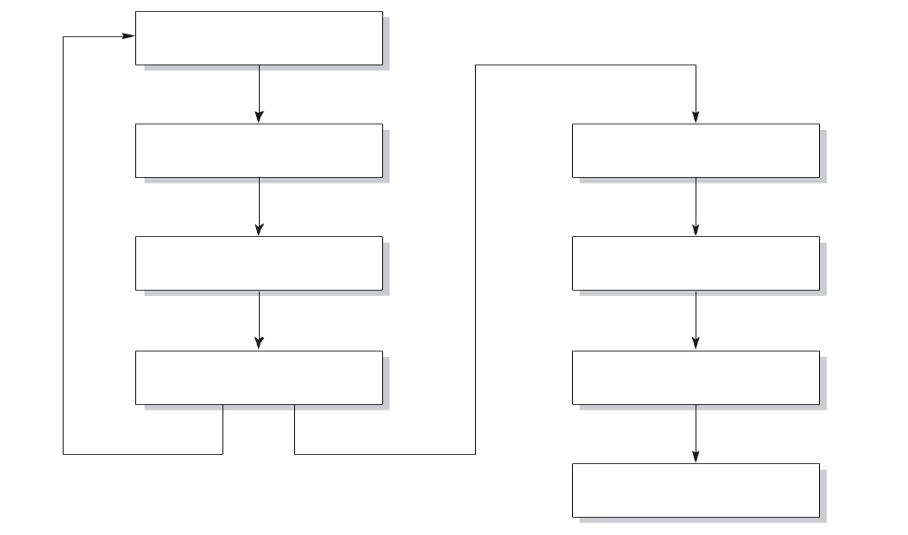
Prototyping as a tool for requirements engineering
reqs engineering
design
design
implementation
implementation
testing
testing
maintenance
©2008 John Wiley & Sons Ltd.
www.wileyeurope.com/college/van vliet
Notes:
© SE, Lifecycle, Hans van Vliet

Slide 14
Prototyping (cntd)
throwaway prototyping: the n-th prototype is followed by a waterfall-like process (as depicted on previous slide)
evolutionary prototyping: the nth prototype is delivered
©2008 John Wiley & Sons Ltd.
www.wileyeurope.com/college/van vliet
Notes:
© SE, Lifecycle, Hans van Vliet

Slide 15
Point to ponder #2
What are the pros and cons of the two approaches?
©2008 John Wiley & Sons Ltd.
www.wileyeurope.com/college/van vliet
Notes:
© SE, Lifecycle, Hans van Vliet

Slide 16
Prototyping, advantages
The resulting system is easier to use
User needs are better accommodated
The resulting system has fewer features
Problems are detected earlier
The design is of higher quality
The resulting system is easier to maintain
The development incurs less effort
©2008 John Wiley & Sons Ltd.
www.wileyeurope.com/college/van vliet
Notes:
© SE, Lifecycle, Hans van Vliet

Slide 17
Prototyping, disadvantages
The resulting system has more features
The performance of the resulting system is worse
The design is of less quality
The resulting system is harder to maintain
The prototyping approach requires more experienced team members
©2008 John Wiley & Sons Ltd.
www.wileyeurope.com/college/van vliet
Notes:
© SE, Lifecycle, Hans van Vliet
Not that some entries on these lists are the same, I.e. some things are listed as both an advantage and as a disadvantage.

Slide 18
Prototyping, recommendations
the users and the designers must be well aware of the issues and the pitfalls
use prototyping when the requirements are unclear
prototyping needs to be planned and controlled as well
©2008 John Wiley & Sons Ltd.
www.wileyeurope.com/college/van vliet
Notes:
© SE, Lifecycle, Hans van Vliet

Slide 19
Incremental Development
a software system is delivered in small increments, thereby avoiding the Big Bang effect
the waterfall model is employed in each phase
the user is closely involved in directing the next steps
incremental development prevents overfunctionality
©2008 John Wiley & Sons Ltd.
www.wileyeurope.com/college/van vliet
Notes:
© SE, Lifecycle, Hans van Vliet
Overfunctionality: bells and whistles are hard to judge. In this type of process, they are postponed to the next iteration, so not developed if not really needed.

Slide 20
Boehm Spiral Model
Revolution of the spiral gives rise to the following activities
  Identify the sub problem which as the highest associated risk
  Find a solution for that problem
Various process models can be coupled with the spiral model in a natural way
SE, Software Lifecycle, Hans van Vliet, ©2008

Slide 21
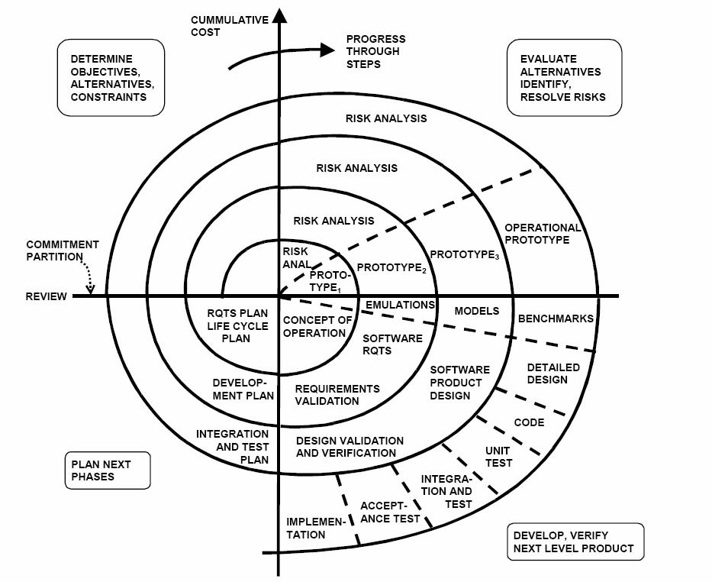

Boehm Spiral Model
SE, Software Lifecycle, Hans van Vliet, ©2008

Slide 22
Agility Principles - I
1. Our highest priority is to satisfy the customer through early and continuous delivery of valuable software.
2. Welcome changing requirements, even late in development. Agile processes harness change for the customer's competitive advantage.
3. Deliver working software frequently, from a couple of weeks to a couple of months, with a preference to the shorter timescale.
4. Business people and developers must work together daily throughout the project.
5. Build projects around motivated individuals. Give them the environment and support they need, and trust them to get the job done.
6. The most efficient and effective method of conveying information to and within a development team is face–to–face conversation.
These slides are designed to accompany Software Engineering: A Practitioner’s Approach, 7/e (McGraw-Hill, 2009) Slides copyright 2009 by Roger Pressman.

Slide 23
Agility Principles - II
7. Working software is the primary measure of progress.
8. Agile processes promote sustainable development. The sponsors, developers, and users should be able to maintain a constant pace indefinitely.
9. Continuous attention to technical excellence and good design enhances agility.
10. Simplicity – the art of maximizing the amount of work not done – is essential.
11. The best architectures, requirements, and designs emerge from self–organizing teams.
12. At regular intervals, the team reflects on how to become more effective, then tunes and adjusts its behavior accordingly.
These slides are designed to accompany Software Engineering: A Practitioner’s Approach, 7/e (McGraw-Hill, 2009) Slides copyright 2009 by Roger Pressman.

Slide 24
RAD: Rapid Application Development
evolutionary development, with time boxes: fixed time frames within which activities are done;
time frame is decided upon first, then one tries to realize as much as possible within that time frame;
other elements: Joint Requirements Planning (JRP) and Joint Application Design (JAD), workshops in which users participate;
requirements prioritization through a triage;
development in a SWAT team: Skilled Workers with Advanced Tools
©2008 John Wiley & Sons Ltd.
www.wileyeurope.com/college/van vliet
Notes:
© SE, Lifecycle, Hans van Vliet
Triage: split requirements in 3 sets: to be done now, to be done later, and things that will be done now if time permits it.
SWAT teams are discussed in chapter 5 as well, a bit.
RAD has much in common with the Scandinavian school, because they both value the role of users in the development process.

Slide 25
Example
Let us consider a Library Information System
Must have
  Include the ability to borrow and return an item and to enroll a member
Should have
  Include facilities to reserve an item
Could have
  Include the ability to handle fines for items returned late
Wont have
  Functions to profile users and notify them of newly arrived items
SE, Software Lifecycle, Hans van Vliet, ©2008

Slide 26
DSDM
Dynamic Systems Development Method, #1 RAD framework in UK
Fundamental idea: fix time and resources (timebox), adjust functionality accordingly
One needs to be a member of the DSDM consortium
DSDM phases
©2008 John Wiley & Sons Ltd.
www.wileyeurope.com/college/van vliet
Notes:
© SE, Lifecycle, Hans van Vliet

Slide 27
DSDM principles
Active user involvement is imperative
Empowered teams
Frequent delivery of products
Acceptance determined by fitness for business purpose
Iterative, incremental development
All changes are reversible
Requirements baselined at high level
Testing integrated in life cycle
Collaborative, cooperative approach shared by all stakeholders is essential
©2008 John Wiley & Sons Ltd.
www.wileyeurope.com/college/van vliet
Notes:
© SE, Lifecycle, Hans van Vliet

Slide 28
XP – eXtreme Programming
Everything is done in small steps
Similar to test method - code walkthroughs and code inspections
Concept of pair programming
The system always compiles, always runs
Client as the center of development team
Developers have same responsibility w.r.t. software and methodology
©2008 John Wiley & Sons Ltd.
www.wileyeurope.com/college/van vliet
Notes:
© SE, Lifecycle, Hans van Vliet
Ontstaan zo rond 1998. Maar bouwt naturlijk wel voort op eerdere ontwikkelingen: AD, evolutionair ontwikkelen ed, spiraal model, scandinavische school, fysische omgeving programmeurs, zoals onderzocht bij bv IBM (telefoon uit)

Slide 29
13 practices of XP
Whole team: client part of the team
Metaphor: common analogy for the system
The planning game, based on user stories
Simple design
Small releases (e.g. 2 weeks)
Customer tests
Pair programming
Test-driven development: tests developed first
Design improvement (refactoring)
Collective code ownership
Continuous integration: system always runs
Sustainable pace: no overtime
Coding standards
©2008 John Wiley & Sons Ltd.
www.wileyeurope.com/college/van vliet
Notes:
© SE, Lifecycle, Hans van Vliet
Voraf wel korte vorbereiding, met beetje architectuur, maar niet echt veel.
Team zonder bazen, met client er midden in
Metafoor: desktop bv.
Planning gebaseerd op scenarios, en soort “kunst”maat: bv story kost 4 bLUBS. En deze week maken we 20 BLUBS. Aan het eind van de week kijken of dat klopt, en je idee van de omvang van een BLUB bijstellen.
In design alleen stoppen wat je nodig hebt; de wereld verandert toch; aardige metFOO HIER: ELKE DAG KAART OPZETTEN EN WEER VOORSPELLEN, IPV EEN KEER PER WEEK.
Client evalueert elke release, en stelt zonodig bij; bepaalt prioriteiten volgende stories, etc.
Pair programming: piloot en copiloot; je kunt het van elkaar overnemen, enz.
Ipv eerst code schrijven, schrijf je eerst de tests
Overwerk leidt tot burnout, fouten, meer overwerk.
Team neemt een of andere standaard aan.

Slide 30
XP – Five Principles
Rapid feedback
Simplicity
Incremental change
Embracing change
Quality work
SE, Software Lifecycle, Hans van Vliet, ©2008

Slide 31
The Scrum approach
Sprint Cycles
  Fixed length, normally 2-4 weeks
  Starting point - Product backlog
  Involve all members to select features/functionality
  Team organizes themselves to develop
  Scrum-master
  Work reviewed
Three phases
  Outlining phase
  Series of Sprint Cycles
  Project Closure
Three roles
  Product owner
  Scrum Development Team
  Scrum Master
SE, Software Lifecycle, Hans van Vliet, ©2008

Slide 32
Differences for developers
Agile: knowledgeable, collocated, collaborative
Heavyweight: plan-driven, adequate skills, access to external knowledge
©2008 John Wiley & Sons Ltd.
www.wileyeurope.com/college/van vliet
Notes:
© SE, Lifecycle, Hans van Vliet
Volgende reeks slides geven aantal globale verschillen aan

Slide 33
Differences for customers
Agile: dedicated, knowledgeable, collocated, collaborative, representative, empowered
Heavyweight: access to knowledgeable, collaborative, representative, empowered customers
©2008 John Wiley & Sons Ltd.
www.wileyeurope.com/college/van vliet
Notes:
© SE, Lifecycle, Hans van Vliet
Bij de laatste: dat hoop je maar; defensie voorbeeld van Gerrit

Slide 34
Differences for requirements
Agile: largely emergent, rapid change
Heavyweight: knowable early, largely stable
©2008 John Wiley & Sons Ltd.
www.wileyeurope.com/college/van vliet
Notes:
© SE, Lifecycle, Hans van Vliet

Slide 35
Differences for architecture
Agile: designed for current requirements
Heavyweight: designed for current and foreseeable requirements
©2008 John Wiley & Sons Ltd.
www.wileyeurope.com/college/van vliet
Notes:
© SE, Lifecycle, Hans van Vliet

Slide 36
Differences for size
Agile: smaller teams and products
Heavyweight: larger teams and products
©2008 John Wiley & Sons Ltd.
www.wileyeurope.com/college/van vliet
Notes:
© SE, Lifecycle, Hans van Vliet

Slide 37
Differences for primary objective
Agile: rapid value
Heavyweight: high assurance
©2008 John Wiley & Sons Ltd.
www.wileyeurope.com/college/van vliet
Notes:
© SE, Lifecycle, Hans van Vliet

Slide 38
Summary
Traditional models focus on control of the process
There is no one-size-fits-all model; each situation requires its own approach
A pure project approach inhibits reuse and maintenance
©2008 John Wiley & Sons Ltd.
www.wileyeurope.com/college/van vliet

